Slide 1

Unit - 6
https://github.com/

Slide 2
Objective
Git and GitHub​
Difference between Git and GitHub​
Version Controlling​
Most popular Git commands​
Branching in Git​
Connecting local with remote repo​
Hands-on GitHub​

Slide 3

Git
Git is software for tracking changes.
Handle any set of files
Used for work among programmers collaboratively
Developing source code during software development.
https://git-scm.com/downloads/logos

Slide 4

GitHub
Provider of Internet hosting for software development and version control.
Offers the distributed version control
Supports source code management (SCM)
https://github.com/logos

Slide 5
Difference between git and GitHub
Git | GitHub
Installed locally | Hosted in cloud
First released in 2005 | Company launched in 2008
Maintained by The Linux Foundation | Purchase in 2018 by Microsoft
Focused on version control and code sharing | Focused on centralized source code hosting
Primarily a command-line tool | Administered through the web
No user management features | Built-in user management
Minimal external tool configuration features | Active marketplace for tool integration
Competes with Mercurial, Subversion, IBM, Rational Team Concert and ClearCase | Competes with Atlassian Bitbucket and GitLab
Open source licensed | Includes a free tier and pay-for-use tiers

Slide 6
Version Controlling
Version control (also known as revision control, source control, or source code management)
Responsible for managing changes to computer programs.
Handle documents, large web sites, or other collections of information.

Slide 7
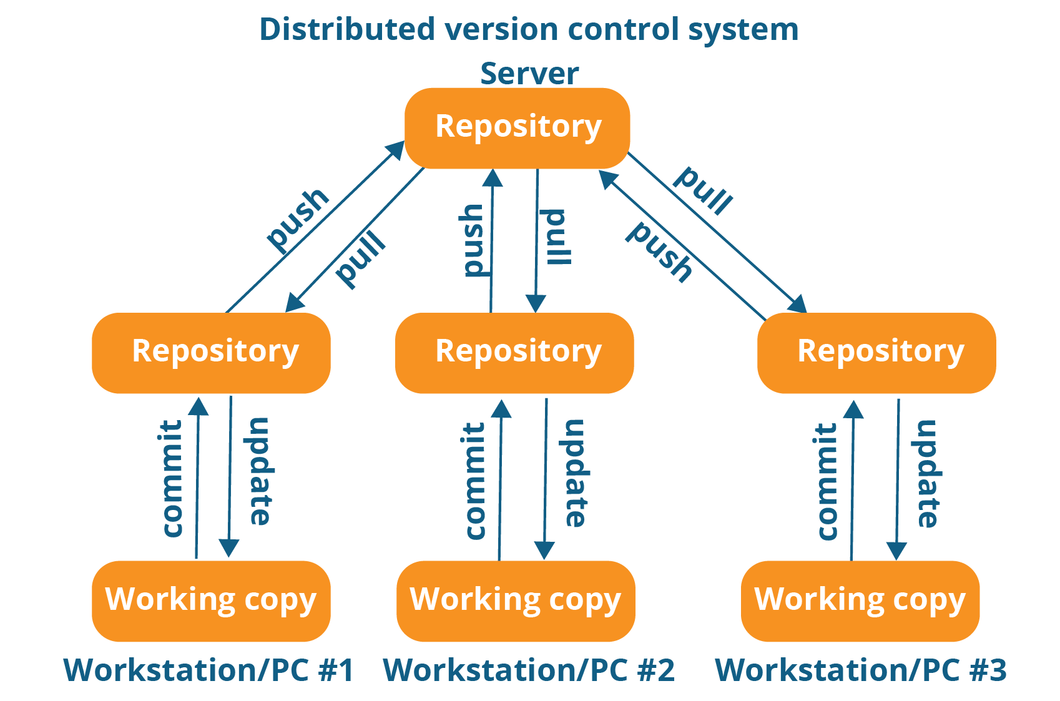
Distributed Version Control
Distributed control

Slide 8
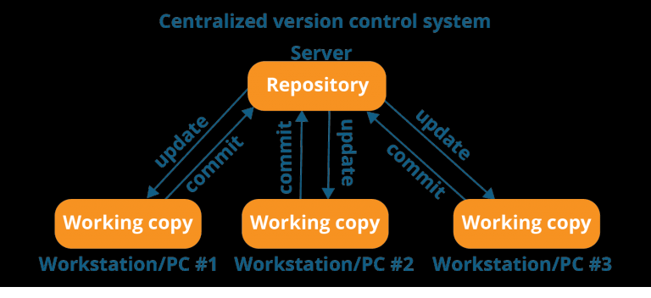
Centralized Version Control
Centralised control

Slide 9
1. What is full form of VCS?
Version Configuration System
Version consolidated System
Version configuration Solution
Version Control System

Slide 10
1. What is full form of VCS?
Version Configuration System
Version consolidated System
Version configuration Solution
Version Control System

Slide 11
2. Git is _______ Version Control system
Distributed
Centralized

Slide 12
2. Git is _______ Version Control system
Distributed
Centralized

Slide 13
3. Match the following:
Git
Github
Cloud Service
Software to track versions

Slide 14
3. Match the following:
Git
Github
Cloud Service
Software to track versions

Slide 15
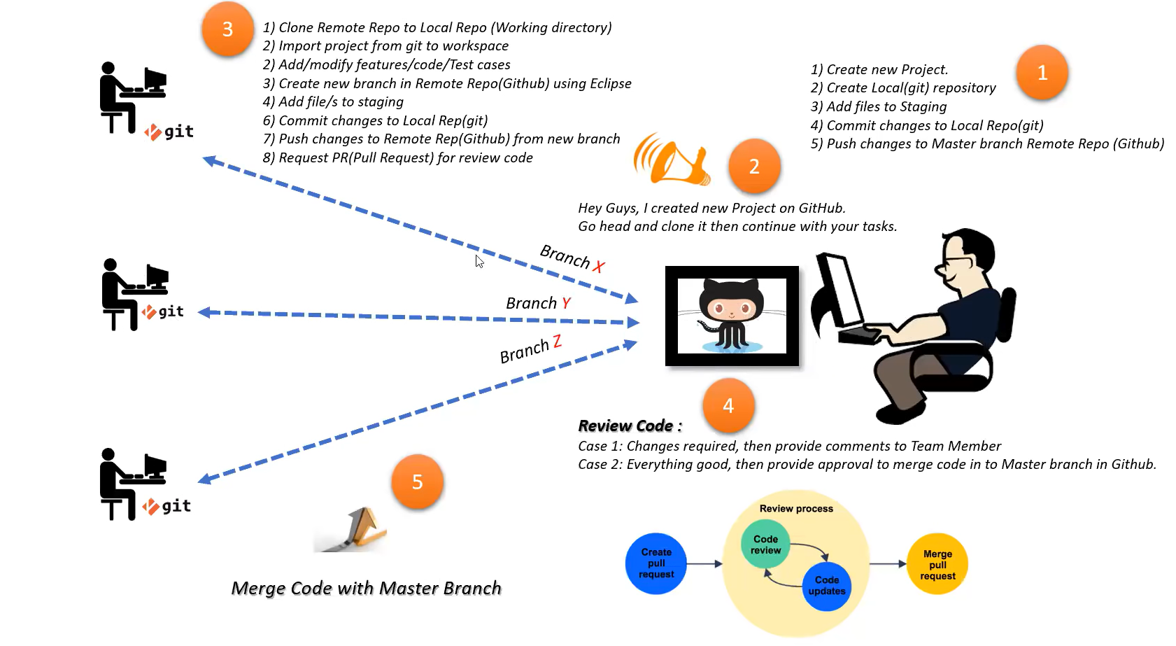
Code-Cycle
Flowgraph

Slide 16


Git CMD Vs Git bash
Git CMD just like Windows CMD.​
Can call all Git features​
Git Bash emulates bash environment
Also support Unix commands
Git-bash

Slide 17
Git commands
add
commit
config
init
add
commit
config
init
branch
checkout
merge
log
remote add
push
branch
check-out
merge
log
remote add
push
https://education.github.com/git-cheat-sheet-education.pdf

Slide 18
Processing Stages
Untracked : Files which are newly created in working directory and git does not aware of these files.
Staged: Files which are added to staging area. These files are ready to commit.
Committed: Files which is committed and placed in local repository/ Committed State.
Modified: File which is already tracked by git. But is modified in working directory .

Slide 19
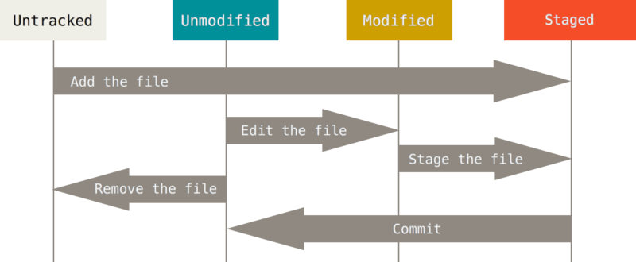
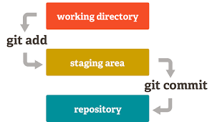
Git-flow
Untracked file – Red color
Staging Area – Green Color
Staging Tree

Slide 20
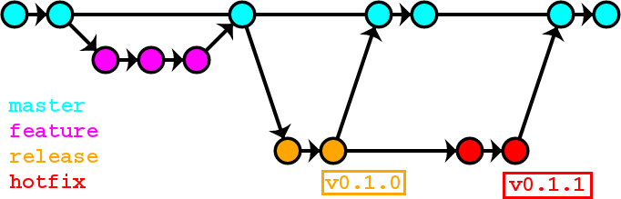
Branching
Source - [7]
Master and branch

Slide 21
Create account on GitHub
https://github.com/join?ref_cta=Sign+up&ref_loc=header+logged+out&ref_page=%2F&source=header-home

Slide 22
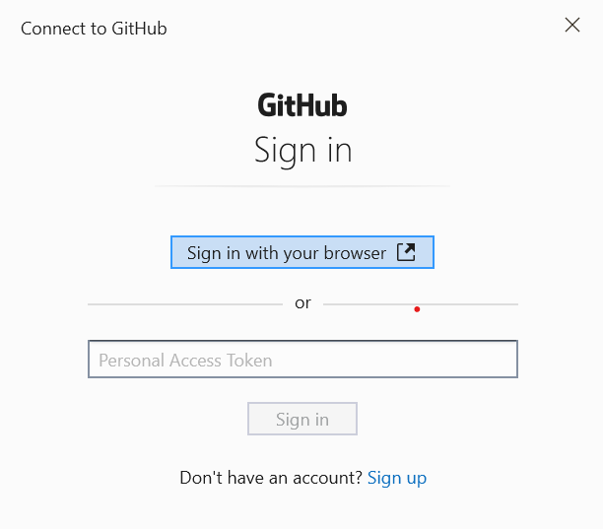

Slide 23
References
https://en.wikipedia.org/wiki/Git
Jason Long, CC BY 3.0 <https://creativecommons.org/licenses/by/3.0>, via Wikimedia Commons
https://en.wikipedia.org/wiki/GitHub
GitHub, Public domain, via Wikimedia Commons
https://www.geeksforgeeks.org/difference-between-git-and-github/
https://en.wikipedia.org/wiki/Version_control
Qeef, CC BY-SA 4.0 <https://creativecommons.org/licenses/by-sa/4.0>, via Wikimedia Commons
Scott Chacon and Ben Straub , Pro Git , Second edition , Apress , 2014.
Git and GitHub for beginners - Crash course by freeCodeCamp.org - https://www.youtube.com/watch?v=RGOj5yH7evk&t=408s

